Slide 1
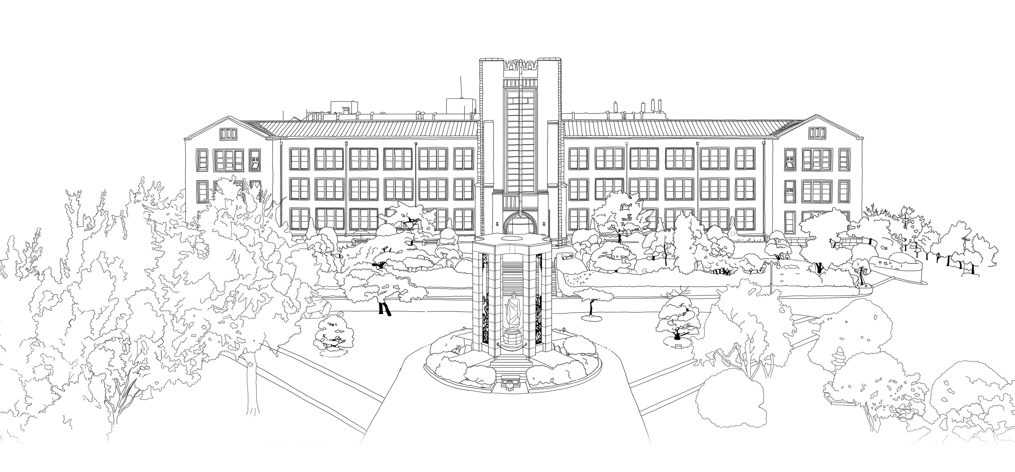
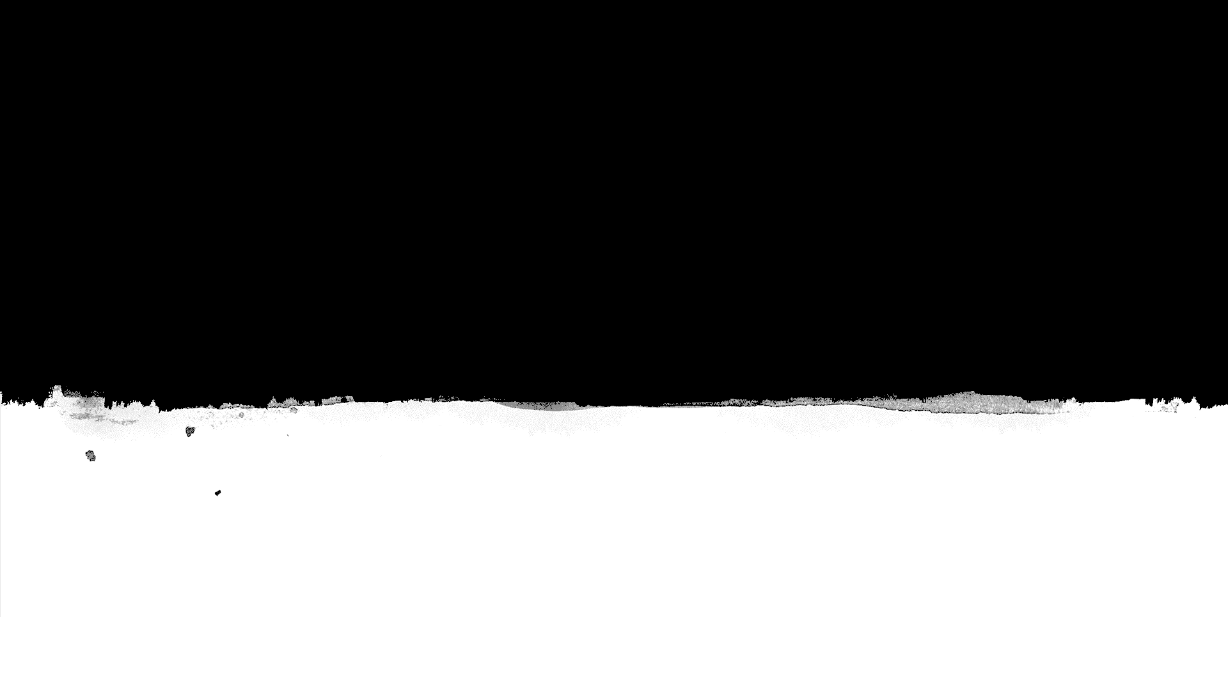

A New Image Quality Metric for Image Auto-Denoising
K. Xiangfei, L.Kuan and Y.Qingxion, ” A New Image Quality Metric for Image Auto-Denoising” ICCV, 2013, pp. 2888-2895.
DongYeon Kim
Department of Multimedia Engineering
Dongguk University
Notes:
goodmorning, everyone.
I will present the paper, titled “A New Image Quality Metric for Image Auto-Denoising”.
It was published on ICCV in two thousand thirteen.

Slide 2
Contents
Introduction
Related Works
Proposed Metric
Experimental Results
Conclusion
Notes:
The table of contents is as follows.
I will present in order of Introduction, Related Works, Proposed Metric, Experimental Results, and Conclusion

Slide 3
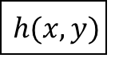
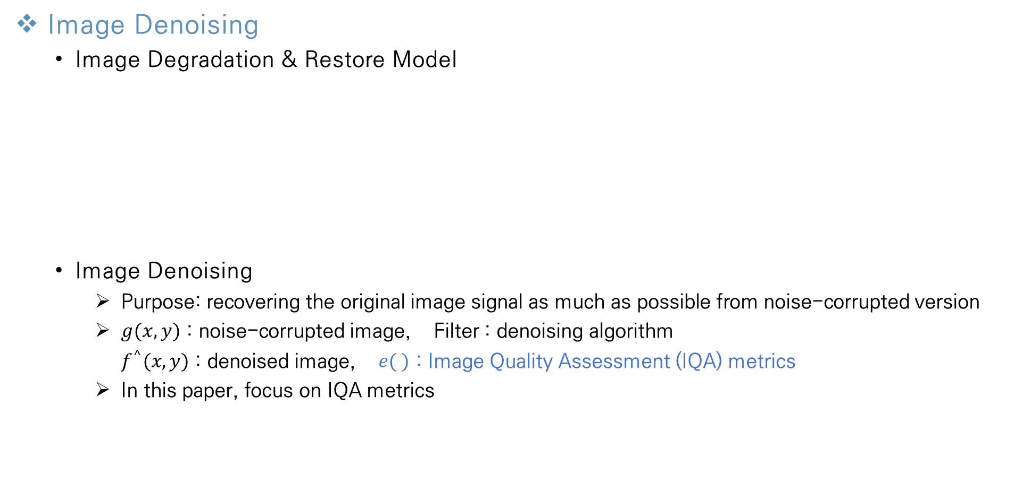
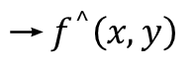
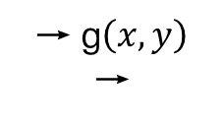
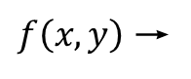
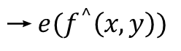
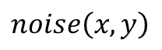
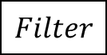
Introduction
Image Denoising
Image Degradation & Restore Model
Image Denoising
Purpose: recovering the original image signal as much as possible from noise-corrupted version
$g(x,y)$ : noise-corrupted image, Filter : denoising algorithm
$f^{^}(x,y)$ : denoised image, $e( )$ : Image Quality Assessment (IQA) metrics
In this paper, focus on IQA metrics
$$noise\left(x,y\right)$$
→
$f\left(x,y\right)$ →
$$h(x,y)$$
→
+
→ g$\left(x,y\right)$ →
$$Filter$$
$$\text{→} f^{^}\left(x,y\right)$$
$$\text{→} {e(f}^{^}\left(x,y\right))$$
Original image
Degradation function
Result image
Restoration function
Restored image
Evaluate
restored image
Denoising & evaluating part
Notes:
At first, I’ll introduce the image degradation & restore model.
There are original image f(x,y) which don’t have any distortion.
And if Some degradation function are applied to the image and some noise are added to original image naturally, result image is generated that we commonly see.
And to make this image as similar as the original image, we apply some effective filter and evaluate the similarity, using some appropriate metrics.
In image denoising part, we want to recover the original image signal, as much as possible from noise-corrupted version.
The function g(x,y) corresponds to the noise-corrupted image, filter corresponds to the denoising algorithm, and f^(x,y) is denoised image.
And lastly the function e is the image quality assessment metrics which is called IQA metrics
And in this paper, they focus on the IQA metrics

Slide 4
Introduction
Motivation
Typical image quality assessment (IQA) metrics cannot be used
Mean squared error (MSE)
Peak signal to noise ratio (PSNR)
No-reference IQA metrics are emerging
Existing metrics are computationally expensive
Require different mean opinion scores collected from humans
Notes:
In denoising algorithm, we usually don’t have an original image which is same with reference image.
We normally have only noisy image.
So typical image quality assessment metrics cannot be used like mean squared error called MSE or Peak signal to noise ratio called PSNR
So, No-reference Image quality assessment metrics which do not need a reference image are emerged.
But most of the existing no-reference Image quality assessment metrics are computationally expensive in training process.
And they require different mean opinion scores collected from human observers

Slide 5
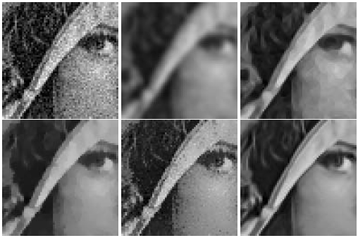
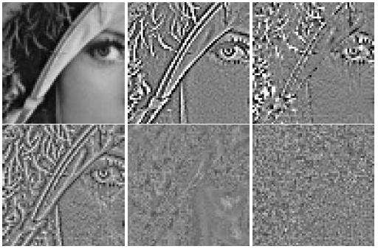
Introduction
proposed metric
The authors propose to use method noise image (MNI)
Only contains a noise
Can make MNI by calculating the difference between noisy image and denoised image.
Can get useful information
[1]
Edge components are considered noise
Well denoised evenly
Denoised image
Method noise image(MNI)
[1]
A. Buades, B. Coll, and J. Morel. A non-local algorithm for image denoising. In CVPR, pages 60–65, 2005.
Notes:
So, authors proposed more robust and accurate but simple metrics. In addition, It is computationally less complexity
In their metric, they use “method noise image” called MNI.
Method noise image contains only noise component and calculated by computing the difference between noisy image and denoised image.
By comparing “method noise image” with noisy image, we can get useful information
These images are about MNI images.
Left images are denoised images with noisy image. From left to right and top to bottom, noisy image, gauss filtering, anisotropic filtering, total variation, neighborhood filtering and NL-means algorithm are applied.
Right images are the MNI images with the original image.
When we compare the denoised images and MNI, If denoised images have much blur effects, there are clear edge is identified in MNI(빨간 동그라미 가르키기)
In this region, There are big difference between noisy image value and denoised image value, because denoising algorithm remove much information in edge region.
And when we see the last images which has the best results in visually, corresponding MNI doesn’t contain clear edge and we can find the noise removed evenly(파란색 가르키기)
Therefore, by comparing MNI and noisy image we can get an information about structure preservation and noise reduction.

Slide 6
Introduction
Goal of proposed metric
Maximize the structure similarity between noisy image & MNI
Maximize the noise reduction
Homogeneous region
Maximize the structure similarity between noisy image & denoised image
Maximize the structure preservation
Highly-structured region
A value that can consider two measurements is used as the IQR method.
Homogeneous
region
Highly-structured
region
Notes:
Using the MNI that we checked in previous slide, the authors proposed a new metrics.
The proposed metric aims at maximizing the structure similarity between (noisy image & MNI) and between (noisy image & denoised image)
By maximizing the structure similarity between noisy (image & MNI), we can maximize the noise reduction around homogeneous region.
If the denoising algorithm effectively eliminate the noise around homogeneous region, there are much noise in MNI’s same region.
That makes the similarity between noisy image and MNI increase.
On the contrary, by maximizing the structure similarity between (noisy image & denoised image), we can maximize the structure preservation around highly structured region.
If the denoising algorithm well preserve the structure information around highly structured region, the similarity between noisy image and denoised image is increased
Therefore, the authors proposed a method which can maximize both of measurements and is used the new IQR method

Slide 7
Related Works
IQA metrics (cont’d)
Category of IQA metrics
The IQA metrics are categorized based on the existence of reference image
Proposed metric is based on SSIM
The performance of proposed metric is compared with the performance of Q-metric
IQA metric
Full-reference
metric
Reduced-reference
metric
No-reference
metric
MSE (RMSE)
PSNR
SSIM
Q-metric
Proposed metric
Notes:
From this page, I’ll introduce about related works
The IQR metrics are categorized based on the existence of reference image which means noise-free image.
This paper introduces the following five metrics importantly.
The proposed metrics is no-reference metric which is based on SSIM.
And the performance of proposed metric is compared with the performance of Q-metric.

Slide 8
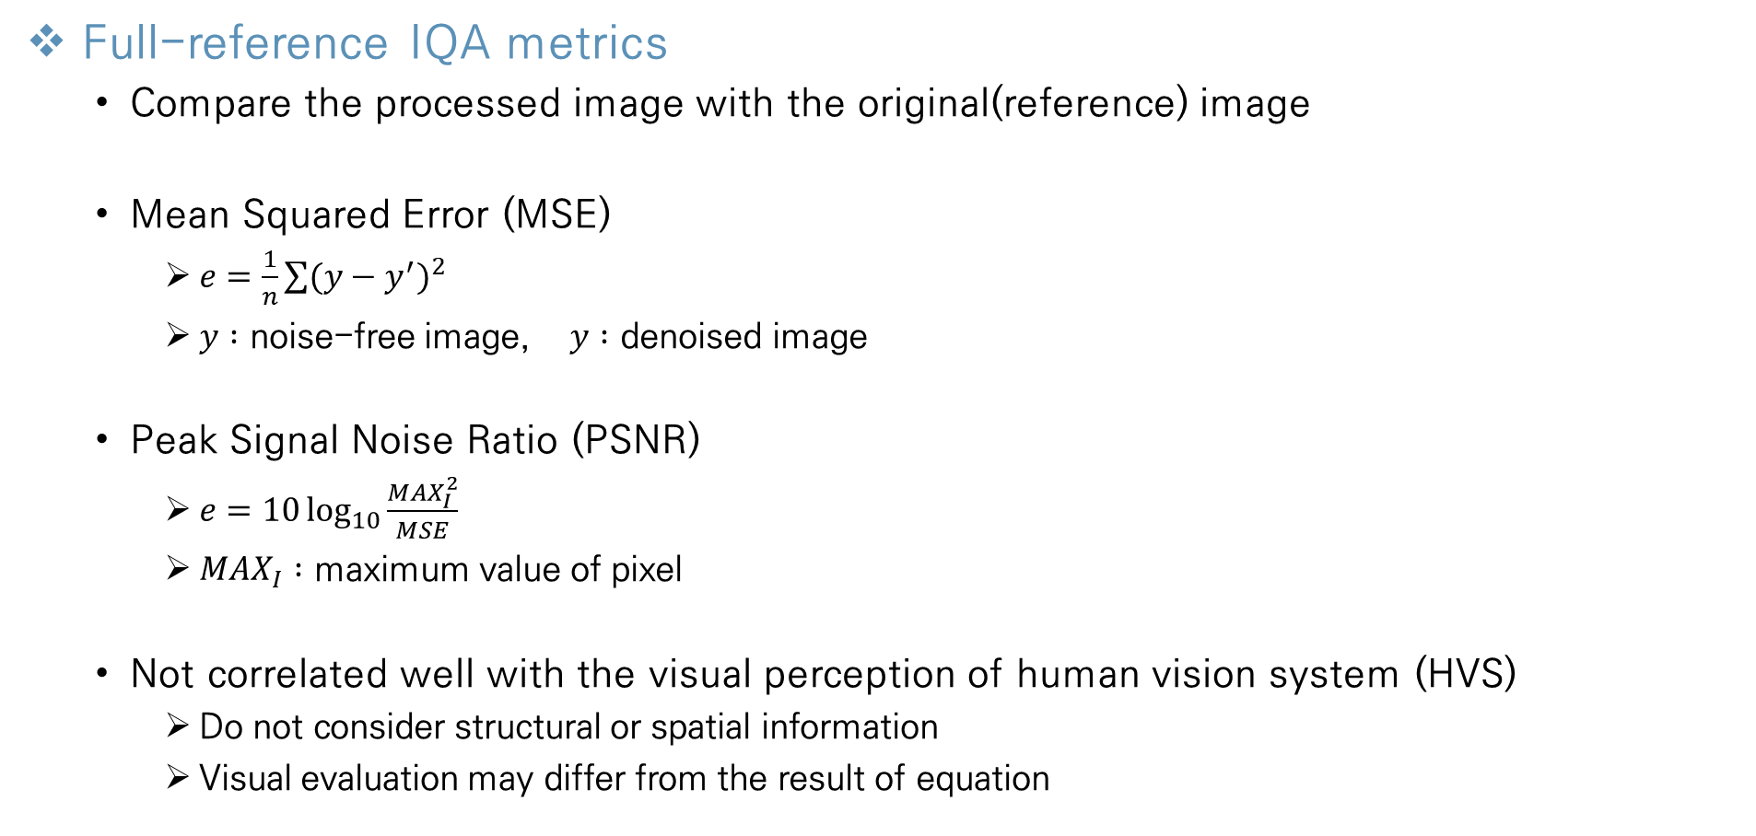
Related Works
Full-reference IQA metrics
Compare the processed image with the original(reference) image
Mean Squared Error (MSE)
$e=\frac{1}{n}\sum{(y−y^{′})^{2}}$
$y :$ noise-free image, $y :$ denoised image
Peak Signal Noise Ratio (PSNR)
$e=10\log_{10}{\frac{MAX_{I}^{2}}{MSE}}$
$MAX_{I} :$ maximum value of pixel
Not correlated well with the visual perception of human vision system (HVS)
Do not consider structural or spatial information
Visual evaluation may differ from the result of equation
Notes:
This page is a description of the various techniques included in the full-reference IQA.
In Full-reference IQA, the denoised image is compared to the original image.
First, mean square error called MSE.
In Mean square error, errors are obtained from all pixels of the original image and the denoised image.
The average of the sum of the squared errors obtained becomes an error value.
Therefore, if the error value is low, there are the smaller differences between original image and denoised image.
Second, Peak signal noise ratio called PSNR.
In PSNR, the ratio of noise to the maximum pixel value that an image may have is expressed.
the maxi means the maximum pixel value, in eight bit image, it is two hundred fifty five.
The smaller the loss, compute higher value, and with the higher loss, compute smaller value.
Both methods are mathematically clear and often used in many applications.
Because structural or spatial information is not considered, the two methods are not suitable for the human vision system.
For example, an image with a relatively high MSE value may be evaluated as a better denoising image visually in humans
Therefore, the results of visual evaluation and equation may be different.
so SSIM is introduced as an evaluation method considering the human vision system.

Slide 9
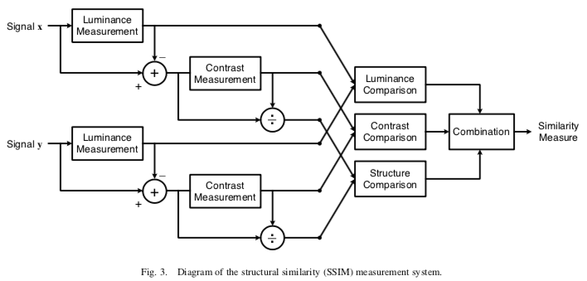
Related Works
Full-reference IQA metrics (cont’d)
Structure Similarity Index Measure (SSIM)
Separate the task of similarity measurement into luminance, contrast, structure
Assume that HVS is highly adapted for structures and less sensitive to the variance of the luminance and contrast
The proposed metric also exploits image structure term in SSIM for image quality assessment
Components of Structure Similarity Index Measure (SSIM)
Step 1 : calculate luminance of input image x, y
Step 2 : calculate contrast of input image x, y
Step 3 : define luminance & contrast comparison
Step 4 : define structure comparison
Step 5 : combination three terms
[2]
[2]
Z. Wang, A. C. Bovik, H. R. Sheikh, and E. P. Simoncelli. Image quality assessment: From error visibility to structural smilarity. TIP, 13(4):600–612, 2004.. .
Notes:
From this page I’ll introduce about SSIM.
As I mentioned SSIM metric makes a significant progress compared to PSNR and MSE.
It is separated in three tasks of similarity measurement into luminance, contrast and structure because it is based on Human vision system.
And they assume that HVS is highly adapted for structures and less sensitive to the variance of the luminance and contrast.
In this paper, proposed metric is based on the image structure term in SSIM, so I’ll introduce the detail components about SSIM
This is overview of the SSIM
In first step~ 하나씩 누르며 읽기

Slide 10
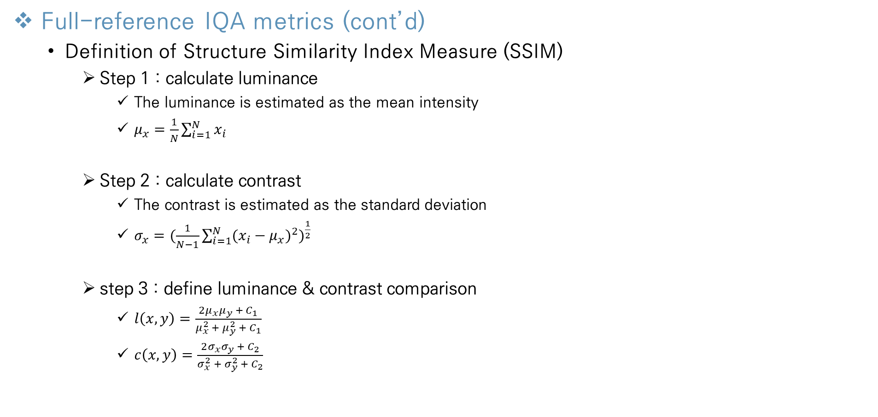
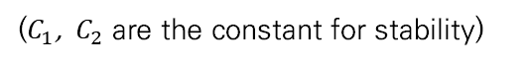
Related Works
Full-reference IQA metrics (cont’d)
Definition of Structure Similarity Index Measure (SSIM)
Step 1 : calculate luminance
The luminance is estimated as the mean intensity
$μ_{x}=\frac{1}{N}\sum_{i=1}^{N}{x_{i}}$
Step 2 : calculate contrast
The contrast is estimated as the standard deviation
$σ_{x}=(\frac{1}{N−1}\sum_{i=1}^{N}{(x_{i}−μ_{x})^{2})^{\frac{1}{2}}}$
step 3 : define luminance & contrast comparison
$l\left(x, y\right)=\frac{2μ_{x}μ_{y} + C_{1}}{μ_{x}^{2} + μ_{y}^{2} +{ C}_{1}}$
$c\left(x, y\right)=\frac{2σ_{x}σ_{y} + C_{2}}{σ_{x}^{2} + σ_{y}^{2} +{ C}_{2}}$
($C_{1}$, ${ C}_{2}$ are the constant for stability)
$l\left(x, y\right)=$ 1 or $c\left(x, y\right)=1,$ when the comparison of luminance or contrast of image $x, y$are same
Notes:
This is the definition about SSIM.
First we calculate the luminance. In SSIM the luminance is estimated as the mean intensity of entire pixels.
So we can compute luminance 뮤x according to this notation.
Second we calculate the contrast. In SSIM the contrast is estimated as the standard deviation.
So according to the definition of standard deviation we can compute contrast
Third they define the comparison of luminance and the contrast.
The important thing in this step is that, when the comparison of luminance or contrast of variable x,y are same, the comparison value equals one.

Slide 11
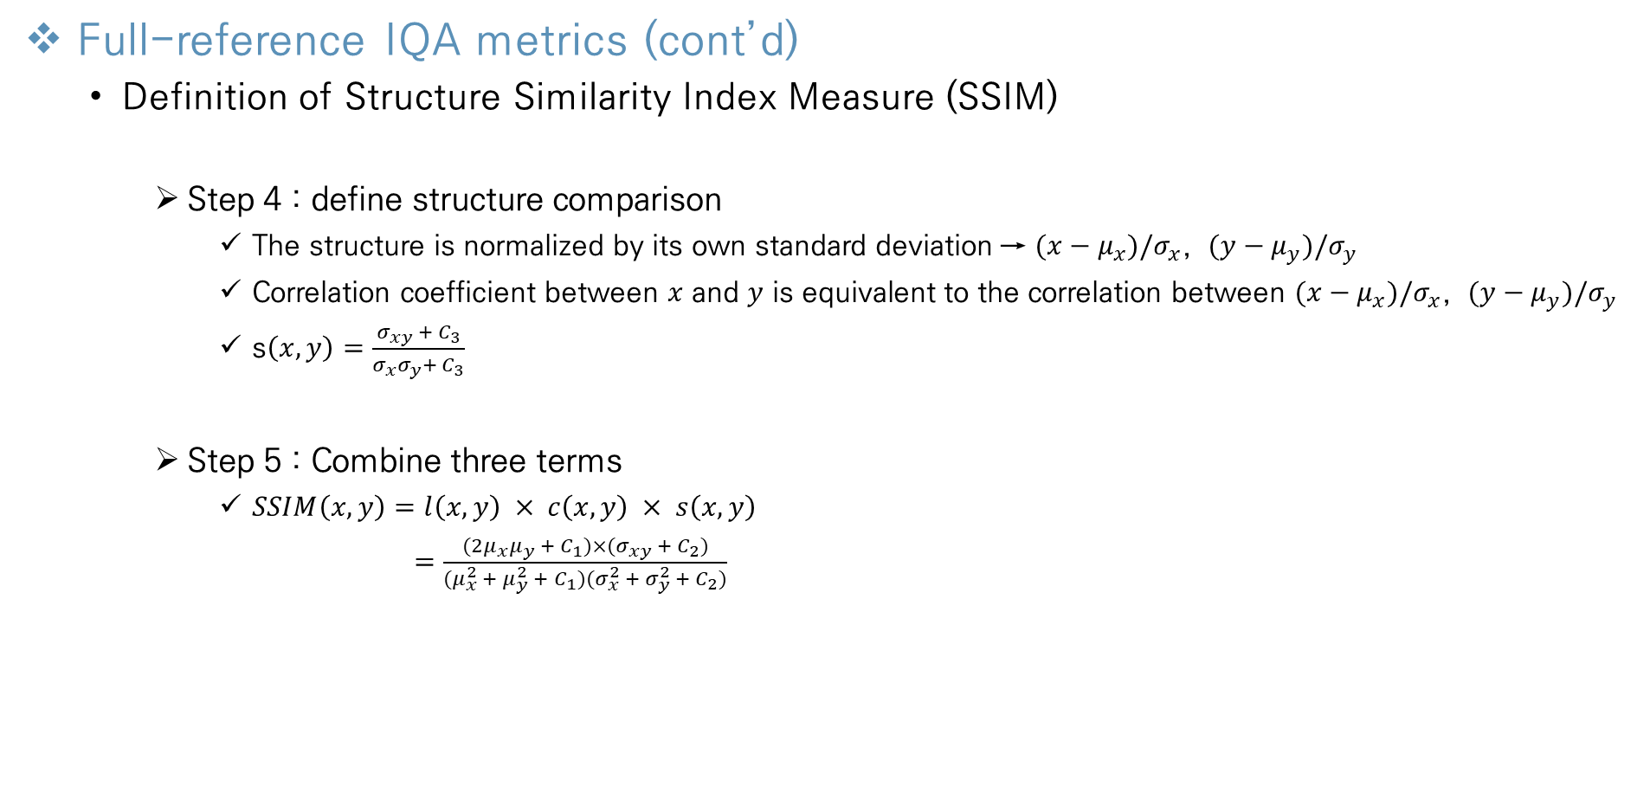
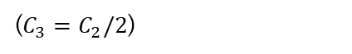
Related Works
Full-reference IQA metrics (cont’d)
Definition of Structure Similarity Index Measure (SSIM)
Step 4 : define structure comparison
The structure is normalized by its own standard deviation → $(x−μ_{x})/σ_{x}$, $(y−μ_{y})/σ_{y}$
Correlation coefficient between $x$ and $y$ is equivalent to the correlation between $(x−μ_{x})/σ_{x}$, $(y−μ_{y})/σ_{y}$
s$\left(x, y\right)=\frac{σ_{xy} + C_{3}}{σ_{x}σ_{y}+{ C}_{3}}$
Step 5 : Combine three terms
$SSIM\left(x,y\right)=l\left(x,y\right) × c\left(x,y\right) × s\left(x,y\right)$
$=\frac{(2μ_{x}μ_{y} + C_{1})×(σ_{xy} + C_{2})}{{(μ}_{x}^{2} + μ_{y}^{2} +{ C}_{1})(σ_{x}^{2} + σ_{y}^{2} +{ C}_{2})}$
($C_{3}=C_{2}/2$)
Now we can evaluate image using luminance, contrast, structure
Notes:
In next step, they define structure comparison.
The structure is normalized by its own standard deviation and luminance.
And they define structure comparison of two variable x,y as the correlation between variable x and y .
So we can get structure comparison function according to correlation coefficient between variable x and y
Finally we can combine those three terms of luminance, contrast, structure comparison.
To summarize the formulation, we can get this SSIM function, and now we can evaluate image using luminance, contrast and structure.

Slide 12
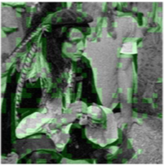
Related Works
Reduced-reference IQA metrics
Utilize only partial information of the reference image
Features are extracted using certain models
compared to extracted features from some representations of noisy images
No-reference IQA metrics
Q-metric
Compared with proposed metric
Step 1: Select sparse patches that have strong structure from the noisy image
Step 2 : compute the score at extracted patches
Step 3 : the average of extracted patches’ is the IQR value
[3]
Selected patches
[3]
X. Zhu and P. Milanfar. Automatic parameter selection for denoising algorithms using a no-reference measure of image content. TIP, 19(12):3116–3132, 2010.
.
Notes:
Until now, I introduced the full-reference iqa metrics
The Reduced reference IQA metrics utilize only partial information of the reference image in terms of features
These features are extracted using certain models and compared to those extracted from some specific representation of the distorted images
And lastly, in this paper, authors introduce the q-metric as an example of No-reference IQA metrics
The performance of this metric is compared with proposed metric
In the q-metric, they divide the whole image to the n by n patches.
For each patch, local coherence is calculated to extract a patch with a strong structure above a specific threshold.
And they compute the score at extracted patches, and the average of extracted patches is the IQR value.
The detailed formula is introduced in this reference.
각 patch에 대하여 local coherence 를 계산하여 특정 threshold 이상의 strong structure 를 가진 patch를 추출함 (대부분 추출되는 patch는 noise가 적은 strong structure부분)
Patch의 component들로 공분산 행렬을 만들고 eigen value차이를 이용해 값을 계산
노이즈가 적을수록 patch의 eigen value의 차이가 커지며, 이 patch는 eigen value의 차이가 큰 지역을 추출한 것

Slide 13
Proposed Metric
Introduction
Parameter setting
Good parameter setting is important to make proper balance between preserving structure and reduction of the noise
preserve too many structural details → denoising effect is insufficient
Remove too much noise → structural details loss
Measurements for evaluating
Noise reduction Map N & Structure preservation Map P
computed by using the similarity comparison from the SSIM
Unlike SSIM, proposed metric don’t use reference image
Notes:
in the q-metric they extract some important patches and evaluate how noisy and structure preserved.
Unlike q-metric the proposed metric is implemented in the entire pixels, and has less computational complexity.
So the proposed metric is more robust and accurate.
Now I introduce about the proposed metric.
In denoising algorithm, a good parameter setting is important to make a proper balance between preserving structure and reduction of the noise.
If denoising algorithm preserve too many structural details, the denoising effect may be insufficient.
Conversely if denoising algorithm remove too much noise, the structural details may be loss.
So proposed metric find the optimized parameter maximizing both of two component.
in proposed metric we will measure the noise reduction map N and structure preservation map P.
Both of those measurements are computed by using the similarity comparison from the SSIM.
But when we use SSIM, we need reference image, but the proposed metric don’t use reference image.

Slide 14
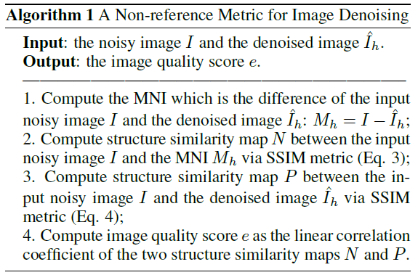
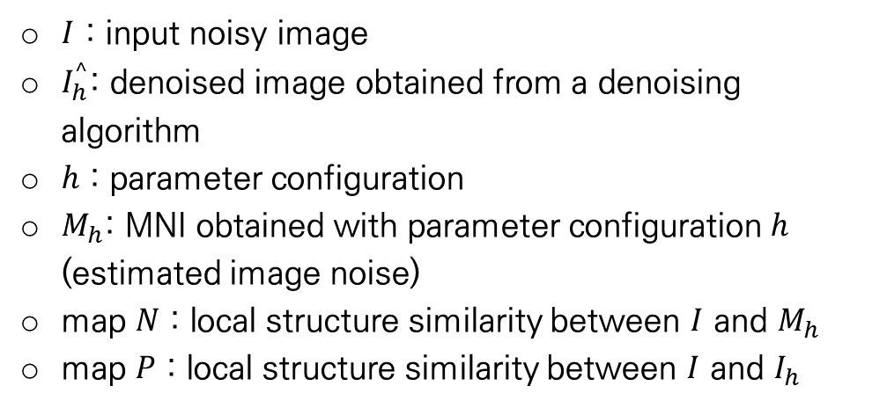
Proposed Metric
Overview
proposed algorithm
$I$ : input noisy image
$I_{h}^{^}$: denoised image obtained from a denoising algorithm
$h$ : parameter configuration
$M_{h}$: MNI obtained with parameter configuration $h$ (estimated image noise)
map $N$ : local structure similarity between $I$ and $M_{h}$
map $P$ : local structure similarity between $I$ and $I_{h}$
Notes:
This is the overview algorithm about the proposed metric.
I is the input noisy image, I^h is the denoised image obtained from a denoising algorithm
H is the parameter configuration Mh is the MNI obtained with parameter configuration h
Map N and P are local structure similarity map between (I and Mh) and (I and Ih)

Slide 15
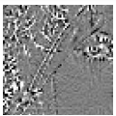
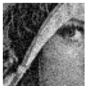
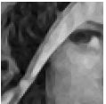
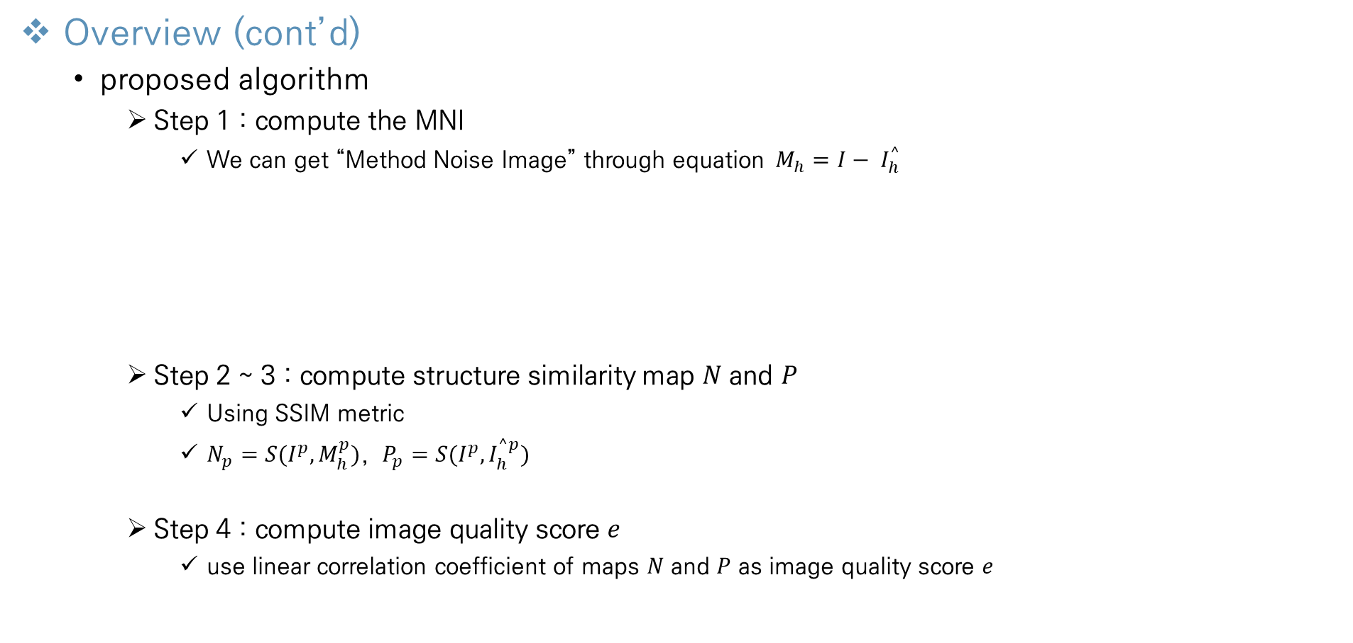
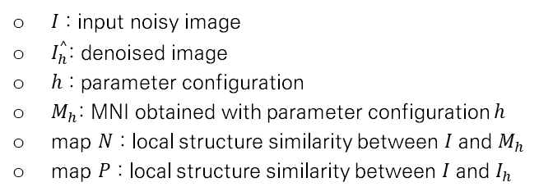
Proposed Metric
Overview (cont’d)
proposed algorithm
Step 1 : compute the MNI
We can get “Method Noise Image” through equation$M_{h}=I− I_{h}^{^}$
Step 2 ~ 3 : compute structure similarity map $N$ and $P$
Using SSIM metric
$N_{p}=S(I^{p}, M_{h}^{p})$, $P_{p}=S(I^{p}, I_{h}^{^p})$
Step 4 : compute image quality score $e$
use linear correlation coefficient of maps $N$ and $P$ as image quality score $e$
=
-
MNI
Noisy image
denoised image
$I$ : input noisy image
$I_{h}^{^}$: denoised image
$h$ : parameter configuration
$M_{h}$: MNI obtained with parameter configuration $h$
map $N$ : local structure similarity between $I$ and $M_{h}$
map $P$ : local structure similarity between $I$ and $I_{h}$
Notes:
And I explain the pseudocode about algorithm.
At first, we compute the MNI. We have noise image and denoised image, so we can compute the method noise image by calculating difference of I and I^h
At second & third step, we will compute structure similarity map N and P, using structure similarity function defined based on SSIM.
And the last, we will compute the image quality score e based on linear correlation coefficient of map N and P
So, when we have input noisy image I and denoised image I^h, this algorithm calculate the image quality score e as an output.
This is the overview of proposed metric, and I will explain more details about each steps

Slide 16
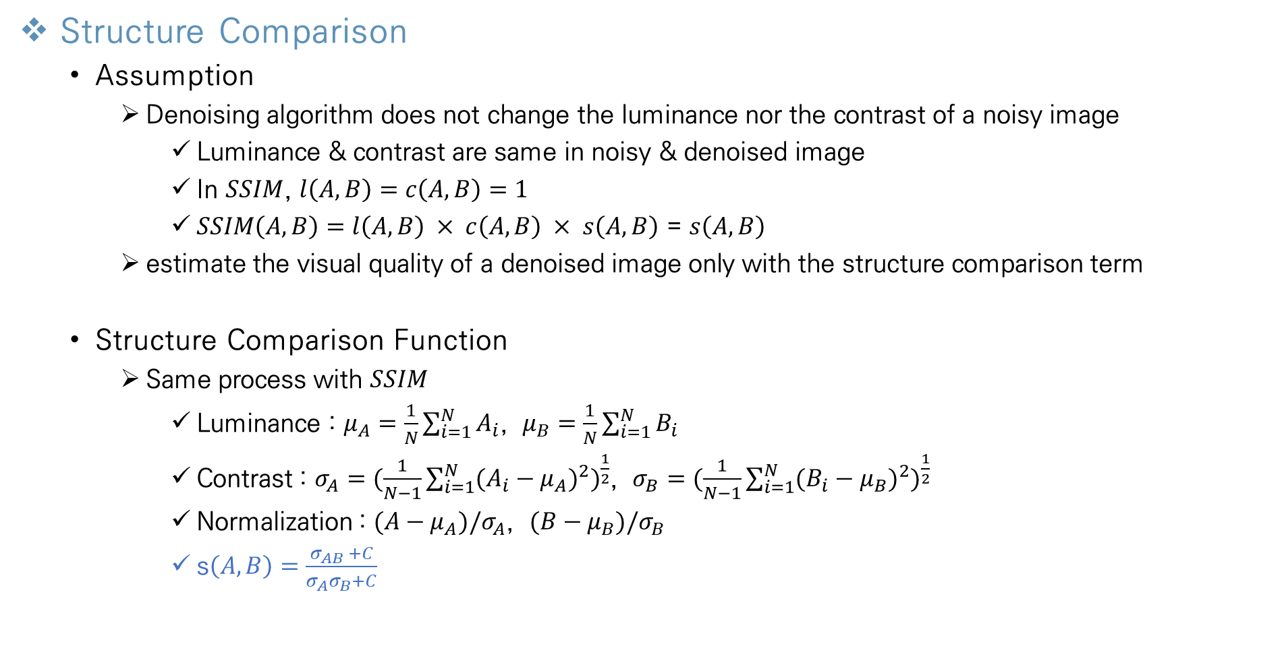
Proposed Metric
Structure Comparison
Assumption
Denoising algorithm does not change the luminance nor the contrast of a noisy image
Luminance & contrast are same in noisy & denoised image
In $SSIM$, $l\left(A,B\right)=c\left(A,B\right)=1$
$SSIM\left(A,B\right)=l\left(A,B\right) × c\left(A,B\right) × s\left(A,B\right)$ = $s\left(A,B\right)$
estimate the visual quality of a denoised image only with the structure comparison term
Structure Comparison Function
Same process with $SSIM$
Luminance : $μ_{A}=\frac{1}{N}\sum_{i=1}^{N}{A_{i}}$, $μ_{B}=\frac{1}{N}\sum_{i=1}^{N}{B_{i}}$
Contrast : $σ_{A}=(\frac{1}{N−1}\sum_{i=1}^{N}{(A_{i}−μ_{A})^{2})^{\frac{1}{2}}}$, $σ_{B}=(\frac{1}{N−1}\sum_{i=1}^{N}{(B_{i}−μ_{B})^{2})^{\frac{1}{2}}}$
Normalization : $(A−μ_{A})/σ_{A}$, $(B−μ_{B})/σ_{B}$
s$\left(A, B\right)=\frac{σ_{AB} +C}{σ_{A}σ_{B}+C}$
Notes:
First we will define the structure comparison function.
In this proposed metrc, we will assume that the denoising algorithm does not change the luminance nor the contrast of a noisy image.
It is an assumption but true most of the time.
Therefore, The luminance & contrast of denoised image are same with those in noisy image .
As I mentioned in SSIM’s luminance & contrast comparison part, if the luminance & contrast of the image A,B are same, the comparison value equals to one.
So, we can calculate the SSIM metric only use structure comparison part, which is the most important term in SSIM.
because it incorporates the comparison of spatial distribution of the image structure.
In the proposed metric, the process about computing luminance, contrast, normalization are same with SSIM,
so structure comparison function is defined as I mentioned in SSIM part.

Slide 17
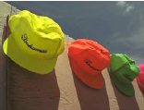
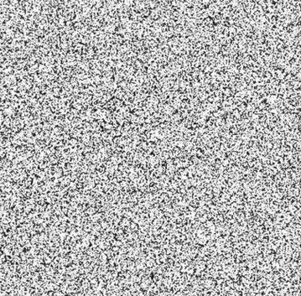
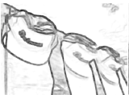
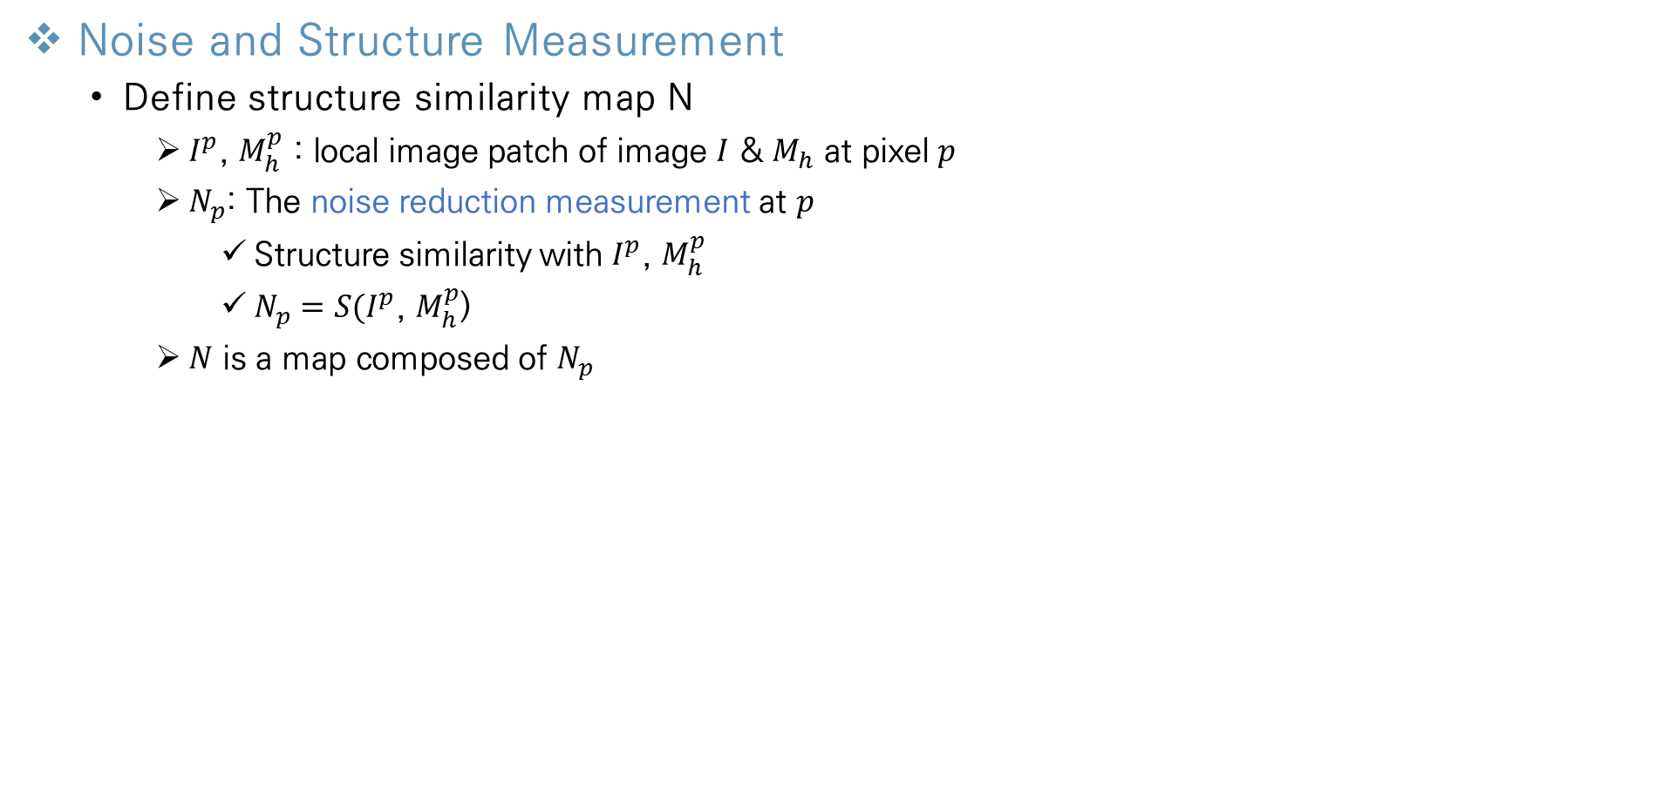
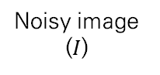
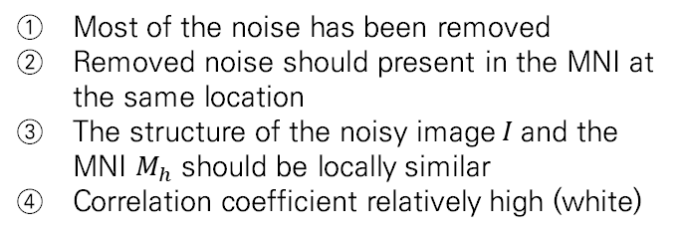
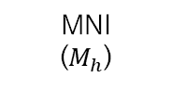
Proposed Metric
Noise and Structure Measurement
Define structure similarity map N
$I^{p}$, $M_{h}^{p}$ : local image patch of image $I$ & $M_{h}$ at pixel$p$
$N_{p}$: The noise reduction measurement at $p$
Structure similarity with $I^{p}$, $M_{h}^{p}$
$N_{p}=S(I^{p}$, $M_{h}^{p}$))
$N$ is a map composed of $N_{p}$
Homogeneous region
Most of the noise has been removed
Removed noise should present in the MNI at the same location
The structure of the noisy image$I$and the MNI $M_{h}$ should be locally similar
Correlation coefficient relatively high (white)
Noisy image ($I$)
MNI
($M_{h}$)
Maps for noise reduction (N)
Notes:
We defined the structure similarity function.
Now we compute the structure similarity map N
As I mentioned the proposed metrics is conducted on entire pixels.
So $I^{p}$ and $M_{h}^{p}$ mean local image patch of image $I$ & $M_{h}$ at pixel p.
The variable $N_{p}$ is the noise reduction measurement at pixel p which means the structure similarity with $I^{p} and$ $M_{h}^{p}$
And the N is a map composed of $N_{p}$
These images are the noisy image, MNI, and the result Map N which is obtained by computing the structure similarity at every pixels.
(한번 누르기)In the homogeneous region, most of the noise has been removed by denoising algorithm.
So removed noise should present in the MNI at the same location.
And then the structure of the noisy image I and the MNI $M_{h}$ should be locally similar
Therefore correlation coefficient relatively high in this region so it represented white.

Slide 18
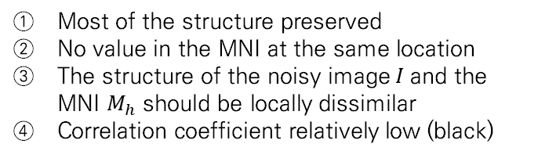
Proposed Metric
Noise and Structure Measurement
Define structure similarity map N
$I^{p}$, $M_{h}^{p}$ : local image patch of image $I$ & $M_{h}$ at pixel$p$
$N_{p}$: The noise reduction measurement at $p$
Structure similarity with $I^{p}$, $M_{h}^{p}$
$N_{p}=S(I^{p}$, $M_{h}^{p}$))
$N$ is a map composed of $N_{p}$
Highly textured region
Most of the structure preserved
No value in the MNI at the same location
The structure of the noisy image$I$and the MNI $M_{h}$ should be locally dissimilar
Correlation coefficient relatively low (black)
Noisy image ($I$)
MNI
($M_{h}$)
Maps for noise reduction (N)
Notes:
Conversely, In the highly textured region, most of the structure information has been preserved by denoising algorithm.
So there are no values in the MNI at the same location.
And then the structure of the noisy image and the MNI should be locally dissimilar
Therefore the correlation coefficient relatively low in this region so it represented black.

Slide 19
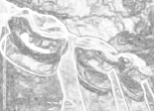
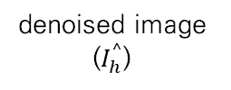
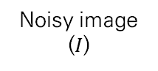
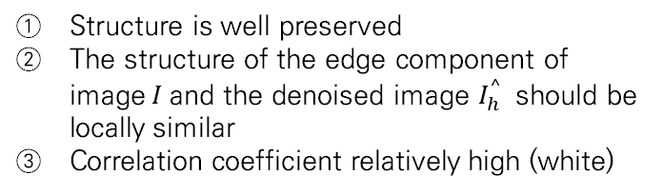
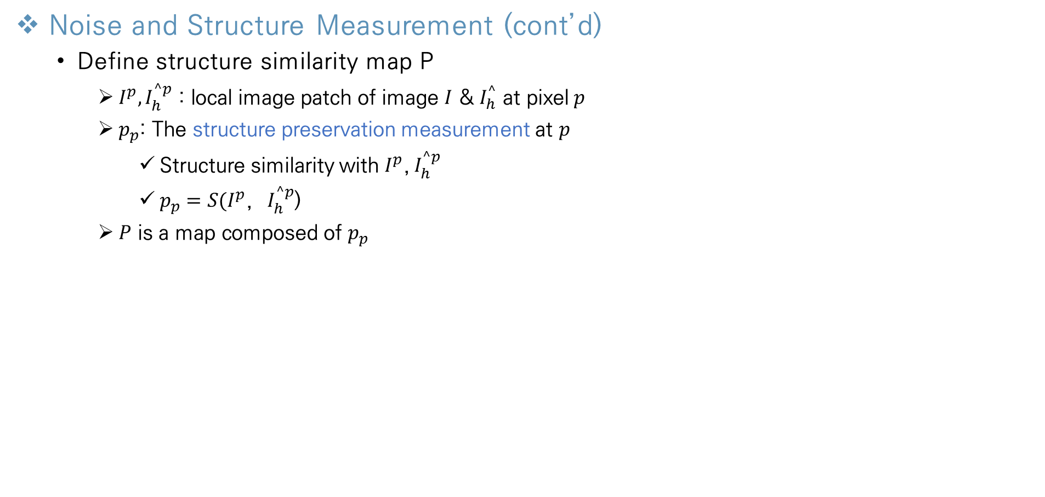
Proposed Metric
Noise and Structure Measurement (cont’d)
Define structure similarity map P
$I^{p}, I_{h}^{^p}$ : local image patch of image $I$ & $I_{h}^{^}$ at pixel$p$
$p_{p}$: The structure preservation measurement at $p$
Structure similarity with $I^{p}$,${ I}_{h}^{^p}$
$p_{p}=S(I^{p}$, $I_{h}^{^p}$))
$P$ is a map composed of $p_{p}$
Highly textured region
Structure is well preserved
The structure of the edge component of image$I$and the denoised image $I_{h}^{^}$ should be locally similar
Correlation coefficient relatively high (white)
Noisy image ($I$)
denoised image ($I_{h}^{^}$)
Maps for structure
Preservation (P)
Notes:
Next we have to compute the structure similarity map P
Same with the process of map N,
The $I^{p}$ and $I_{h}^{^p}$ mean local image patch of image $I$ & $I_{h}^{^}$at pixel p.
The variable $P_{p}$ is the structure preservation measurement at pixel p which means the structure similarity with $I^{p} and{ I}_{h}^{^p}$
And the P is a map composed of $P_{p}$
These images are the noisy image, denoised image and result Map P which is obtained by computing the structure similarity at every pixels.
(한번 누르기) In the highly textured region, most of the structure information are well preserved by denoising algorithm.
So the structure of the edge component of image I and the denoised image $I_{h}^{^}$ should be locally similar
Therefore correlation coefficient relatively high in this region so it represented white.

Slide 20
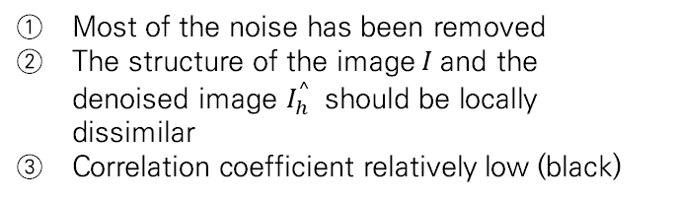
Proposed Metric
Noise and Structure Measurement (cont’d)
Define structure similarity map P
$I^{p}, I_{h}^{^p}$ : local image patch of image $I$ & $I_{h}^{^}$ at pixel$p$
$p_{p}$: The structure preservation measurement at $p$
Structure similarity with $I^{p}$,${ I}_{h}^{^p}$
$p_{p}=S(I^{p}$, $I_{h}^{^p}$))
$P$ is a map composed of $p_{p}$
Homogeneous region
Most of the noise has been removed
The structure of the image$I$and the denoised image $I_{h}^{^}$ should be locally dissimilar
Correlation coefficient relatively low (black)
Noisy image ($I$)
denoised image ($I_{h}^{^}$)
Maps for structure
Preservation (P)
Notes:
Conversely, In the homogeneous region, most of the noise has been removed
So the structure of the noisy image I and the denoised image $I_{h}^{^}$ should be locally dissimilar
Therefore correlation coefficient relatively low in this region so it represented black.

Slide 21
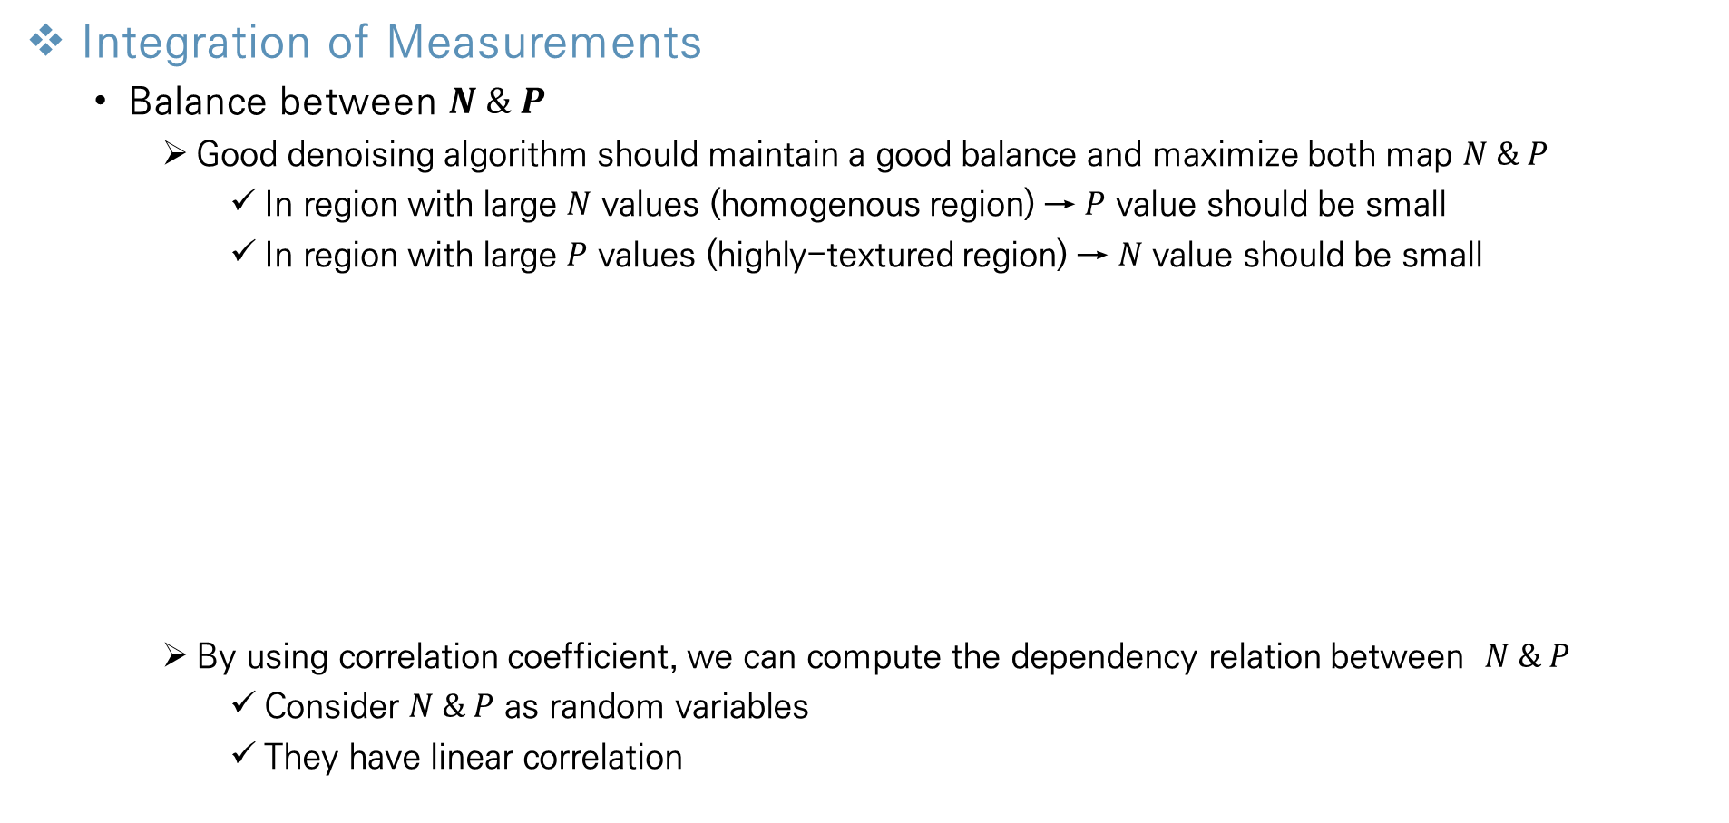
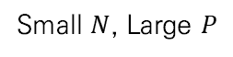
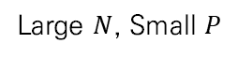
Proposed Metric
Integration of Measurements
Balance between $N \& P$
Good denoising algorithm should maintain a good balance and maximize both map $N \& P$
In region with large $N$ values (homogenous region) → $P$ value should be small
In region with large $P$ values (highly-textured region) → $N$ value should be small
By using correlation coefficient, we can compute the dependency relation between $N \& P$
Consider $N \& P$ as random variables
They have linear correlation
Large $N$, Small $P$
Small $N$, Large $P$
Maps for noise reduction (N)
Maps for structure preservation
(P)
Notes:
According to what we have checked so far, Map N & P incorporate the spatial information of the noise reduction & structure preservation.
And good denoising algorithm should maintain a good balance and maximize both map N & P.
In the region with large N values which is correspond to homogenous value of left image should have small p value.
Conversely, in the region with small n values which is correspond to highly-structured region should have large p value.
These opposite linear properties between map N and map P are computed by using linear correlation coefficient.

Slide 22
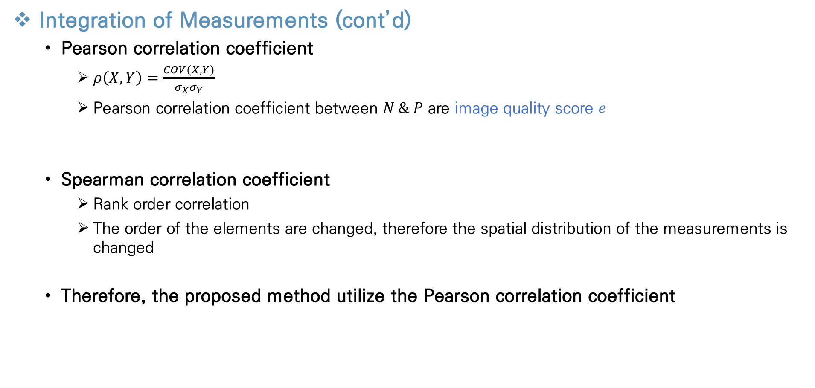
Proposed Metric
Integration of Measurements (cont’d)
Pearson correlation coefficient
$ρ\left(X,Y\right)=\frac{COV(X,Y)}{σ_{X}σ_{Y}}$
Pearson correlation coefficient between $N \& P$ are image quality score $e$
Spearman correlation coefficient
Rank order correlation
The order of the elements are changed, therefore the spatial distribution of the measurements is changed
Therefore, the proposed method utilize the Pearson correlation coefficient
Notes:
In this paper they use pearson correlation coefficient.
Because value N and P have linear relationship.
Also, they have a negative correlation value because if N get bigger, P needs to get smaller.
Another option, there is a Spearman correlation coefficient.
But it is based on rank order correlation.
So the order of the elements are changed, therefore spatial distribution of the measurements is changed
Therefore in this case pearson correlation coefficient value becomes image quality score e
분모는 각 확률변수가 각각 변하는 정도를 분자는 함께 변하는 정도를 나타내며 n이 변함에 따라 p값이 어떻게 변하는지를 나타낸다

Slide 23
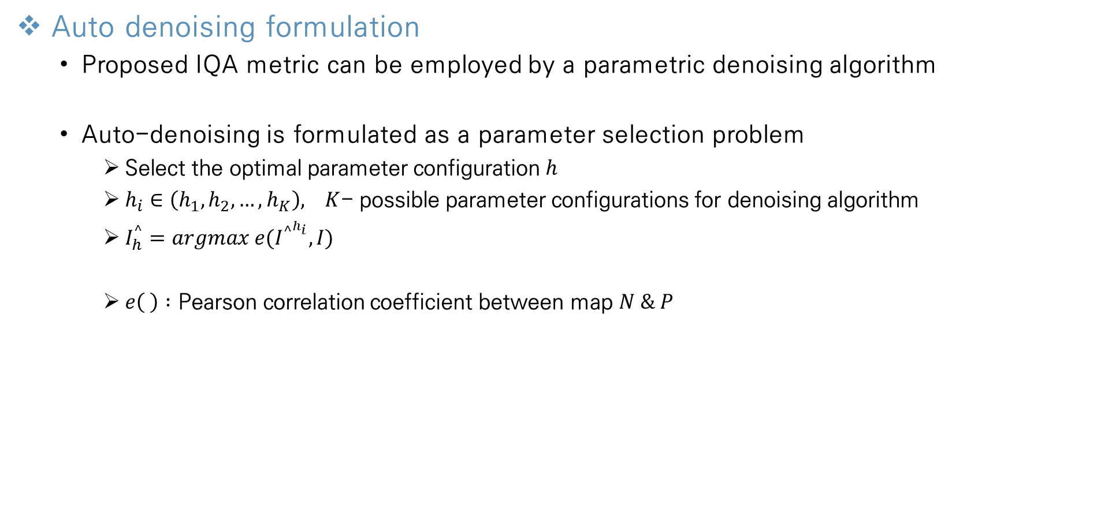
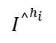
Proposed Metric
Auto denoising formulation
Proposed IQA metric can be employed by a parametric denoising algorithm
Auto-denoising is formulated as a parameter selection problem
Select the optimal parameter configuration $h$
$h_{i}∈\left(h_{1},h_{2},…,h_{K}\right), K$- possible parameter configurations for denoising algorithm
$I_{h}^{^}=argmax e(I^{{^}^{h_{i}}},I)$
$e\left( \right) :$ Pearson correlation coefficient between map $N \& P$
$$I^{{^}^{h_{i}}}$$
Notes:
And this is the last step.
The proposed metric can be employed by a parametric denoising algorithm.
And auto denoising is formulated as a parameter selection problem.
The optimized parameter means select the optimal parameter configuration h
So when we set parameter configuration set, according to this equation, we can find the optimized parameter.

Slide 24
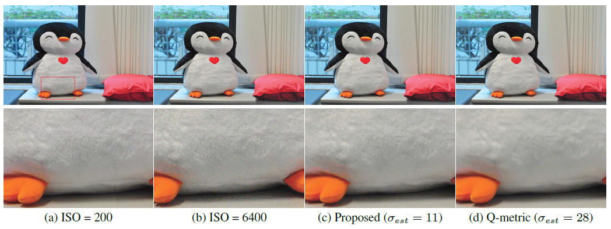
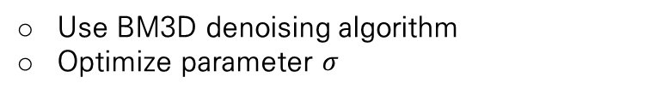
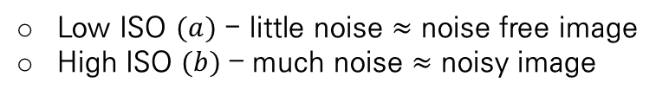
Experimental Results
Denoising with Real Noisy Images
Images are captured with digital camera
Low ISO $(a)$ - little noise $≈$ noise free image
High ISO $(b)$ – much noise $≈$ noisy image
[4]
Use BM3D denoising algorithm
Optimize parameter $σ$
Well preserved structure
Blur effect
Noisy!!
Well denoised
[4]
K. Dabo, A. Foi, V. Katkovnik, and K. Egiazarian. Image denoising by sparse 3-d transform-domain collaborative filtering. TIP, 16(8):2080–2095, 2007..
Notes:
From this page I will introduce about experimental results
This is the first experiment result about real noisy images.
Two images are captured with digital camera.
(a) image captured with low iso. It means that this image has little noise. So it is regarded as noise free image.
(b) Image captured with high iso. It means that it has much noise. So it is regarded as noisy image.
We can find the noise in the shadow region.
they use block matching 3d denoising algorithm called BM3D and optimize parameter sigma.
(c) Image is the denoised algorithm using proposed metric and (d) is the q-metric
When we look at the shadow region both of them, we can find that the noise has been removed well.
But when we see the above region, we can find the blur effect in q-metric image.
And in proposed metric image, it is well preserved compared to the original photo.

Slide 25

Experimental Results
Denoising with Synthetic Noisy Images
The quantitative evaluation is conducted
Two image benchmark datasets $TID 2008$(25 images), $LIVE2$ (29 images)
Use BM3D (parameter $σ$) & SKR denoising algorithm (parameter $i$)
White Gaussian Noise(WGN) is added to the test image
Deviation $σ$ from 5 to 20
Measurement method
Use PSNR metric, because we have reference(original) image
Set optimized parameter using PSNR & compute optimal PSNR value by using original image
Compare PSNR error
[5]
[6]
[7]
PSNR error
Optimal PSNR value
PSNR value
Between
Denoised & noisy image
[5]
N. Ponomarenko, V. Lukin, A. Zelensky, K. Egiazarian, and F. B. M. Carli. TID2008 - a database for evaluation of fullreference visual quality assessment metrics. Adv. Modern Radioelectron., 10:30–45, 2009..
[6]
H. Sheikh, Z. Wang, L. Cormack, and A. Bovik. LIVE image quality assessment database release 2..
[7]
H. Takeda, S. Farsiu, and P. Milanfar. Kernel regression for image processing and reconstruction. TIP, 16(2):349–399, 2007..
Notes:
This is the second experiment about synthetic noisy image
They use two image benchmark dataset TID 2008 and LIVE2, and they use two denoising algorithm BM3D and SKR.
Each algorithm need parameter sigma and I.
And the white gaussian noise is added to the test image, with the range of deviation is from 5 to 20
Because they have reference image unlike common situation, they use PSNR metric as an optimal error value.
They set optimized parameter using PSNR metric and compute the optimal PSNR value by using original image.
And they define a new measurement PSNR error.
It is computed by calculating the difference between optimal PSNR value and PSNR value obtained when we use proposed and q-metrics.

Slide 26




Experimental Results
Denoising with Synthetic Noisy Images (cont’d)
When noise level($σ$) is low ($σ<1$0)
Proposed metric has lower PSNR error than Q-metric, when using BM3D algorithm $(a), (b)$
Well preserved structure
Blur effect
Notes:
This is the first result about synthetic noisy image.
They focus on the additive white gaussian noise level sigma is low.
According to these graphs, when the noise level is low, the proposed metric has lower PSNR error than Q-metric.
It means that the proposed metric has near PSNR value with optimal PSNR value.
These images are the visual result of the graph.
From the left, it is the original image. And the second images are the noisy images which have additive noise with the sigma value of five and ten.
The third and fourth images are denoised images using the proposed & q-metric, and the last image is the optimal image using PSNR.
From the image above, the region under the eye has difference with proposed and q-metric.
When they use the proposed metric, this region’s texture are well preserved, but when they use q-metric, there are blur effects on same region.
From the image below the region near the window has difference with proposed and q-metric.
It has same result, when they use the proposed metric the texture is well preserved, but q-metric has blur effect.

Slide 27



Experimental Results
Denoising with Synthetic Noisy Images (cont’d)
When noise level($σ$) is high ($σ>15$)
Proposed metric has higher PSNR error than Q-metric, when using SKR algorithm $(c), (d)$
Average PSNR errors in $(c), (d)$ are both lower than 1 when $σ>15$
The performance of the proposed & Q-metric is very close to optimal PSNR metric
Texture details are missing
Notes:
This is the second result about synthetic noisy image.
They focus on the additive white gaussian noise level sigma is high.
According to these graphs, when the noise level is high, the proposed metric has higher PSNR error than Q-metric.
Especially when they use SKR denoising algorithm.
But the values of average PSNR errors in (c) (d) graph, are both lower than one.
It means that the performance of the proposed & q-metric is very close to optimal PSNR metric.
In addition, even though q-metric has a higher PSNR value than proposed, when we evaluate it visually, the proposed metric obtained a better results.
Because when we look at the denoising image (d) which is used q-metric, the texture details are missing.
So it says that in some cases, Having a high PSNR value doesn't always have good visual results.

Slide 28



Experimental Results
Video Denoising
Constant noise level
First 100 frames of the video are used
All Images are corrupted with WGN ($σ$=15)
BM3D denoising algorithm is used
Parameters are fluctuated
Parameters are similar
PSNR error at
optimized parameter
Optimized parameter $σ$
Notes:
this is the experiment result of video denoising.
They use first hundred frames of video.
All frames are corrupted with WGN with noise level fifteen
And BM3D denoising algorithm is used
we can find that proposed metric has better performance in most of frames in first graph.
In second graph we can find the optimized parameter are not fluctuated when they use proposed metric.
But when they use q-metric, the optimized parameter is very fluctuate.

Slide 29

Experimental Results
Video Denoising
Dynamic noise level
First 100 frames of the video are used
The noise level is changed dynamically with respect to the time domain
BM3D denoising algorithm is used
Correlation : 0.937
Correlation : 0.989
PSNR error at
optimized parameter
Optimized parameter $σ$
Notes:
And this is the result about dynamic noise level respect to the time domain.
In this experiment, the results algo support proposed metric.
In first graph, PSNR error is relatively lower than q-metric.
And the correlation of optimized parameter between (proposed metric and PSNR) is larger than between (q-metric and PSNR).

Slide 30

Experimental Results
Human Subject Study
Evaluates the perceptual performance of the metrics
The tested images are corrupted by WGN with 4 levels in {5, 10, 15, 20}
Compare Q-metric & proposed metric
Compare with PSNR
Notes:
And this is the last experiment about human subject study
People evaluate the various images with 4 gaussian noise levels
At first graph, most of people select images which is applied the proposed metric are better.
At second graph, they compare to the PSNR with proposed and PSNR with Q-metric.
The people who select proposed metric has higher average ratio than q-metric in this experiment.

Slide 31
Conclusions
Conclusions about this Paper
Propose a new metric for automatizing existing image/video denoising algorithms
Proposed metric is very simple, robust and efficient
Experimental results demonstrate that the proposed metric outperforms the Q-metric
Notes:
So in conclusion.
The authors propose a new metric for automatizing existing image/video denoising algorithm, searching the optimal parameter.
It is very simple, robust and efficient than previous metrics. Because it calculate structure similarity on every pixels.
And a lot of experimental results demonstrate that the proposed metric outperforms the q-metric

Slide 32
Thank You!

